Slide 1
Project Proposal: Classroom Occupancy Detection System
Dominik Ptaszek
231643

Slide 2

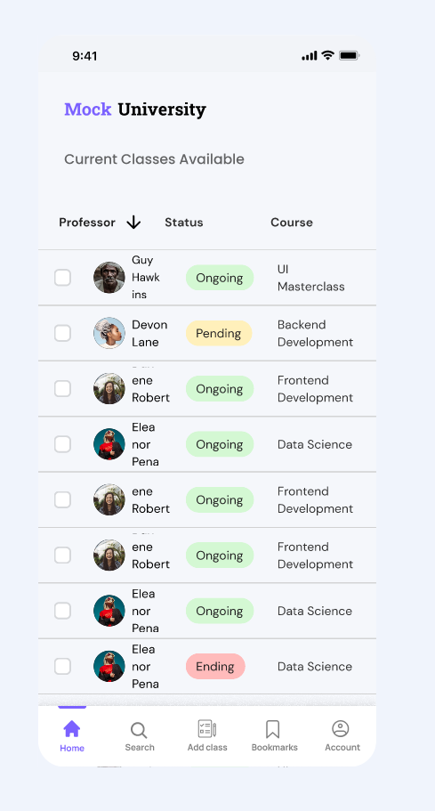
Project Pitch
Business Understanding
Simple tool to manage space in University
Why do we need it ?
Notes:
Time Limit:30 secs
Our application aims to address the inefficiency in quickly identifying and booking accessible study rooms within university settings. This problem leads to wasted time and resources, impacting both students and staff productivity negatively.

Slide 3
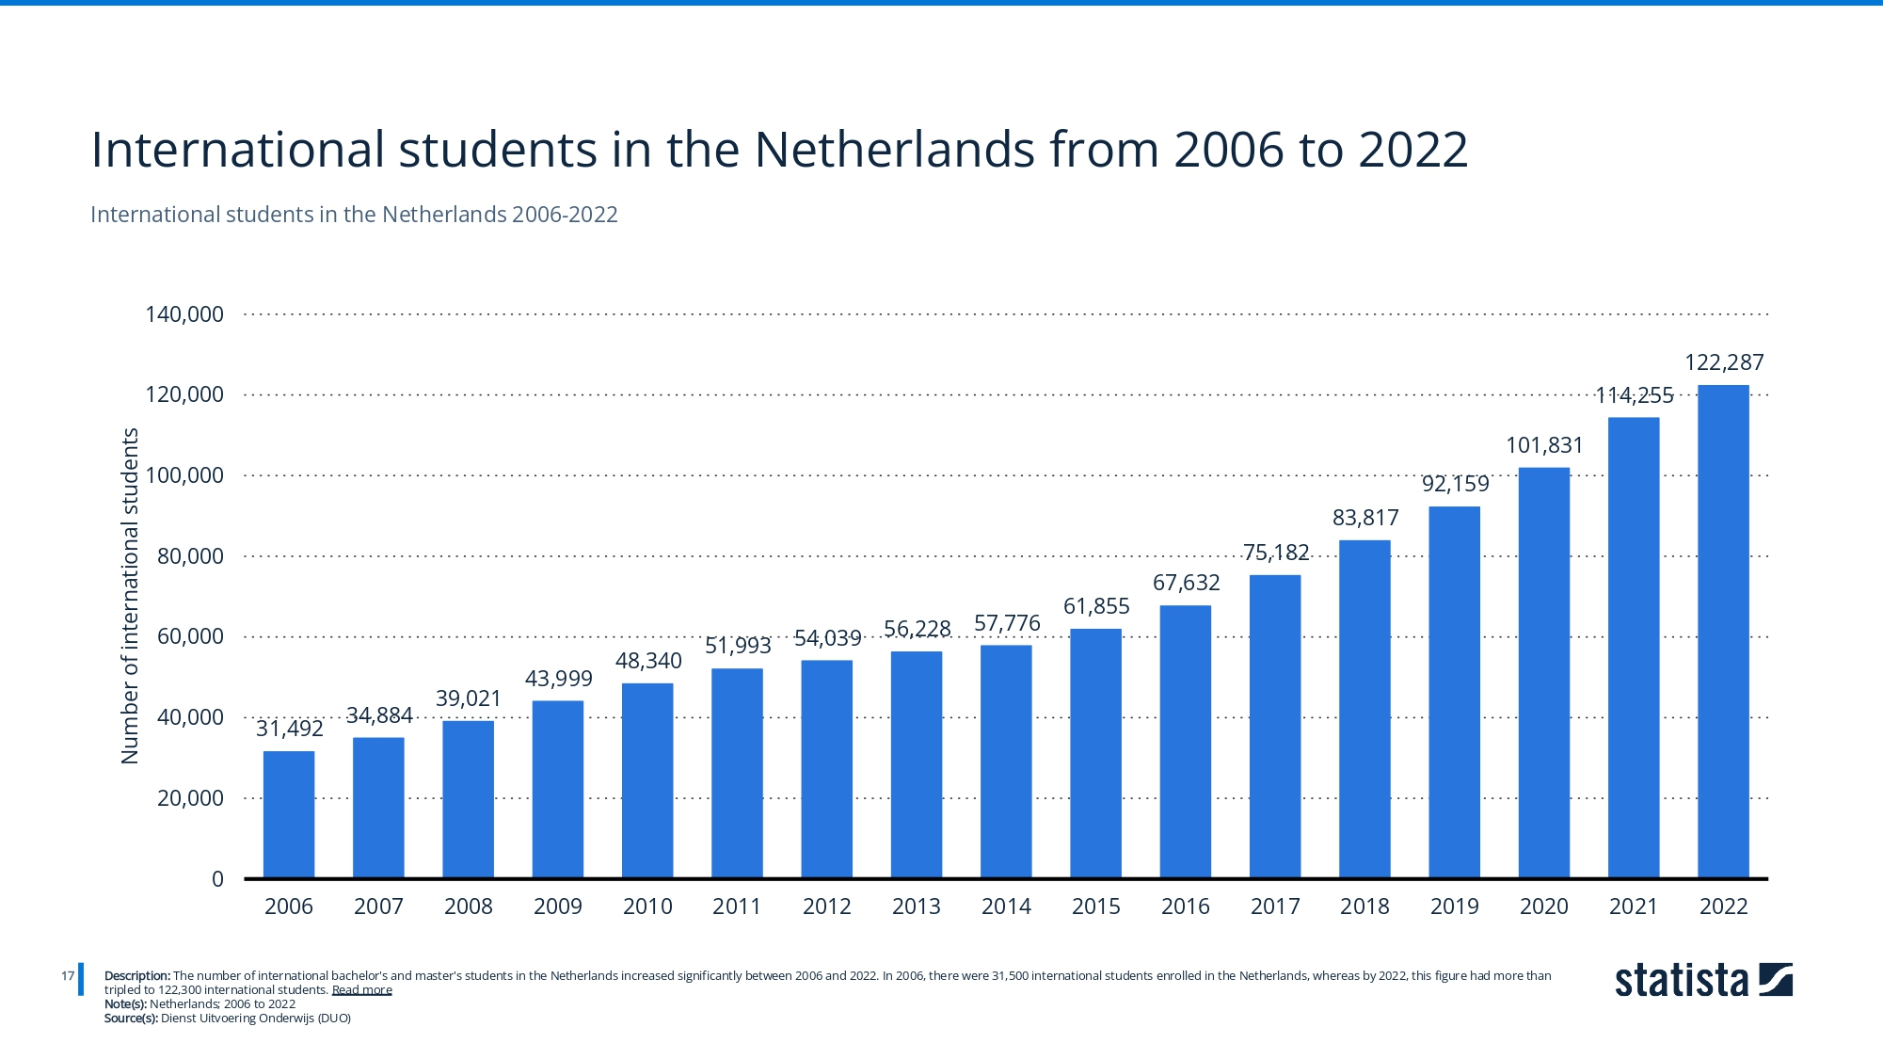
Source:Nuffic. (May 1, 2023). International students in the Netherlands from 2006 to 2022 [Graph]. In Statista. Retrieved April 06, 2024, from https://www.statista.com/statistics/699754/international-students-in-the-netherlands/
Notes:
Time Limit:30 secs
Our application addresses a crucial problem identified through market research within university settings: the inefficiency in quickly identifying and booking accessible study rooms. This issue leads to wasted time and resources, impacting both students and staff productivity negatively. Our main stakeholder, The Innovation Square, represents the university administration responsible for campus facilities and operations.
The needs of The Innovation Square include efficient space utilization to accommodate the growing student population, optimized scheduling and allocation of study spaces, and data-driven insights for making informed decisions regarding resource allocation and space management.
Create the first idea for your application:
Define the problem based on the market research;
Mention your main stakeholder and his needs;
Fill in and present the DAPS diagram;
Explain your idea for an application.
Tell my idea of the APP (how it works, and thanks to that huge universities can better manage their space which will provide them a greater profit. As a result we as student will receive access to more equipment
Basen on market research
To tackle this challenge, we propose a Data-Analytic Problem-Solving (DAPS) approach, outlined in our DAPS diagram. The diagram includes three key components:
1. **Data-Analytic Problem:** Detecting classroom occupancy using machine learning algorithms.
2. **Decision Framework:** Utilizing occupancy data to optimize space management and scheduling.
3. **Business Value:** Enhancing operational efficiency, improving the overall campus experience, and supporting data-driven decision-making in facility management.
Our application concept, named the Classroom Occupancy Detection System (CODS), leverages image classification algorithms to assess visual data from classroom contexts. CODS aims to process and analyze images of classrooms in real-time to determine occupancy status (occupied or vacant). By providing binary classification outputs, CODS aids in optimizing space management and scheduling while supporting decision-making by The Innovation Square to allocate resources effectively and enhance the overall campus experience. This aligns with market demands, addresses stakeholder needs, and offers a practical solution to the identified problem of inefficient space utilization in educational institutions.

Slide 4
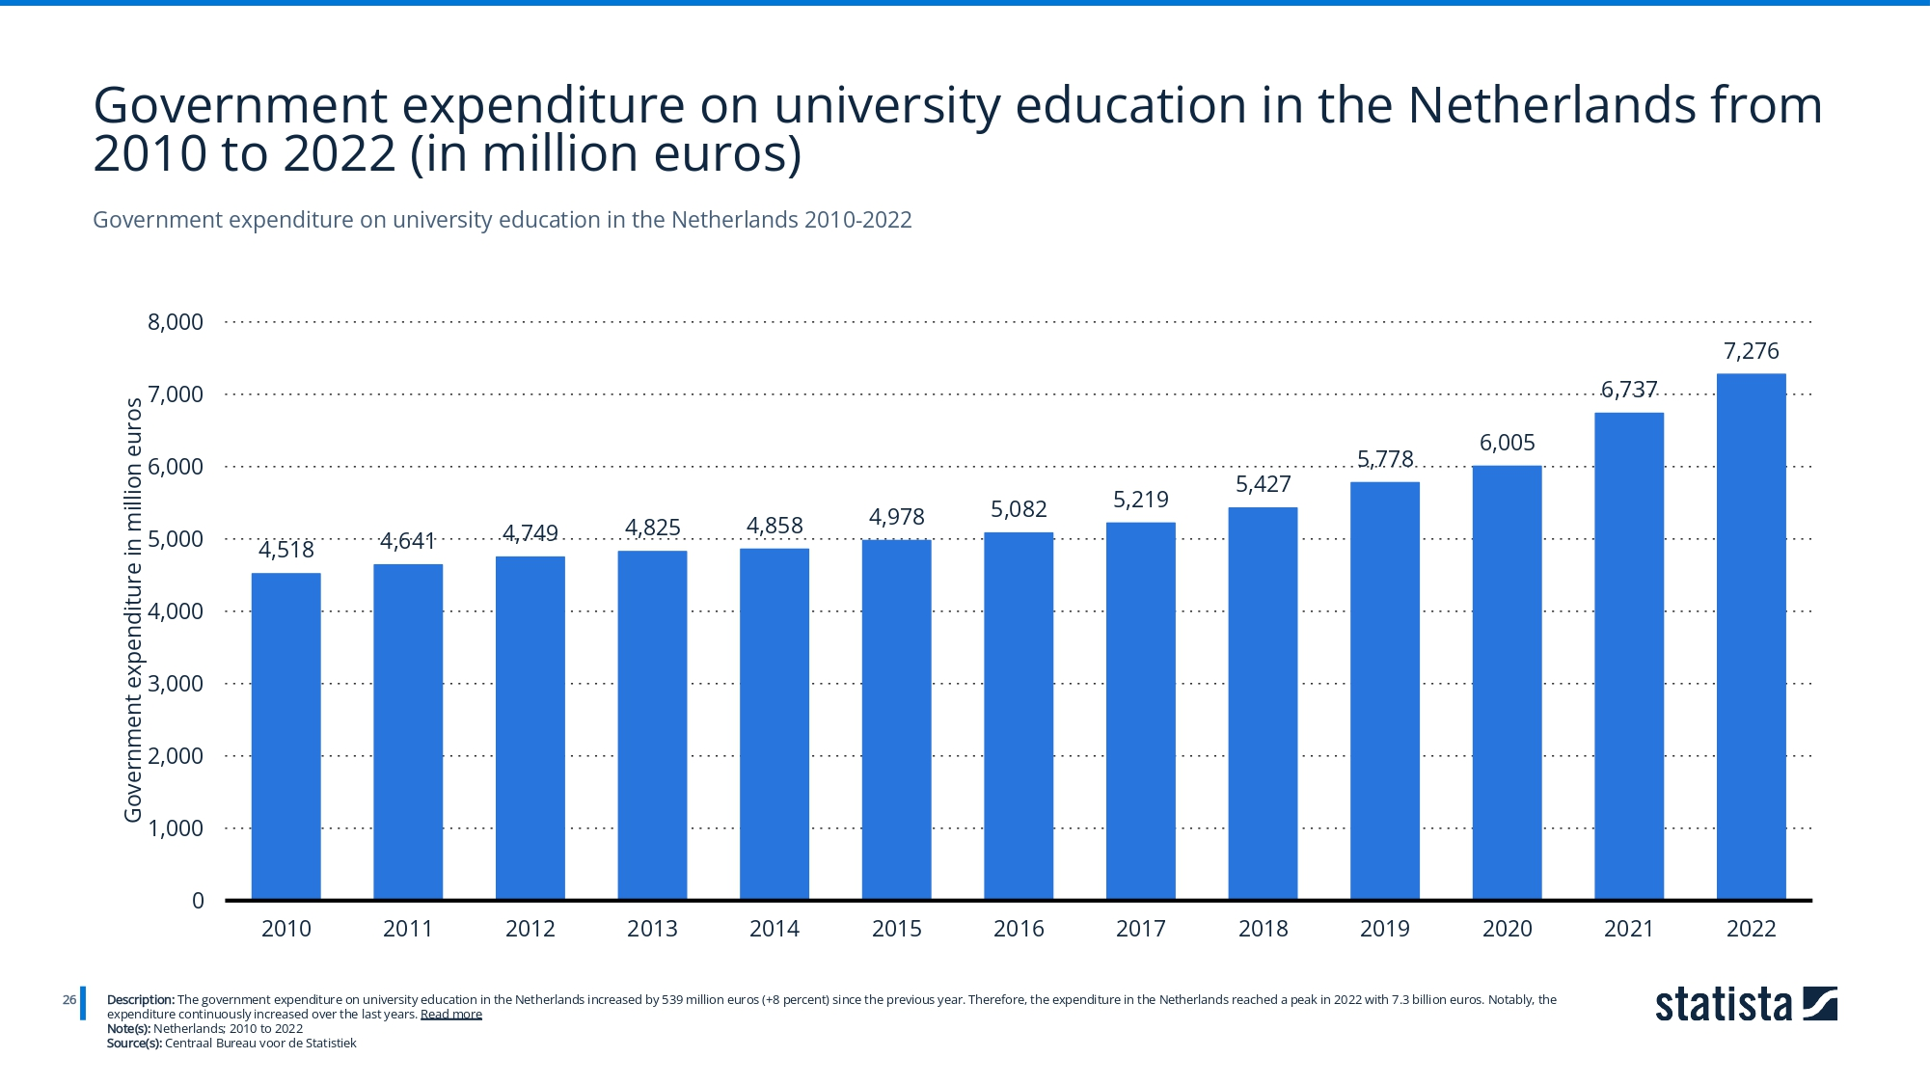
Centraal Bureau voor de Statistiek. (December 7, 2023). Government expenditure on university education in the Netherlands from 2010 to 2022 (in million euros) [Graph]. In Statista. Retrieved April 06, 2024, from https://www.statista.com/statistics/543009/government-expenditure-on-university-education-in-the-netherlands/
Notes:
Our application addresses a crucial problem identified through market research within university settings: the inefficiency in quickly identifying and booking accessible study rooms. This issue leads to wasted time and resources, impacting both students and staff productivity negatively. Our main stakeholder, The Innovation Square, represents the university administration responsible for campus facilities and operations.
The needs of The Innovation Square include efficient space utilization to accommodate the growing student population, optimized scheduling and allocation of study spaces, and data-driven insights for making informed decisions regarding resource allocation and space management.
Create the first idea for your application:
Define the problem based on the market research;
Mention your main stakeholder and his needs;
Fill in and present the DAPS diagram;
Explain your idea for an application.
Tell my idea of the APP (how it works, and thanks to that huge universities can better manage their space which will provide them a greater profit. As a result we as student will receive access to more equipment
Basen on market research
To tackle this challenge, we propose a Data-Analytic Problem-Solving (DAPS) approach, outlined in our DAPS diagram. The diagram includes three key components:
1. **Data-Analytic Problem:** Detecting classroom occupancy using machine learning algorithms.
2. **Decision Framework:** Utilizing occupancy data to optimize space management and scheduling.
3. **Business Value:** Enhancing operational efficiency, improving the overall campus experience, and supporting data-driven decision-making in facility management.
Our application concept, named the Classroom Occupancy Detection System (CODS), leverages image classification algorithms to assess visual data from classroom contexts. CODS aims to process and analyze images of classrooms in real-time to determine occupancy status (occupied or vacant). By providing binary classification outputs, CODS aids in optimizing space management and scheduling while supporting decision-making by The Innovation Square to allocate resources effectively and enhance the overall campus experience. This aligns with market demands, addresses stakeholder needs, and offers a practical solution to the identified problem of inefficient space utilization in educational institutions.

Slide 5
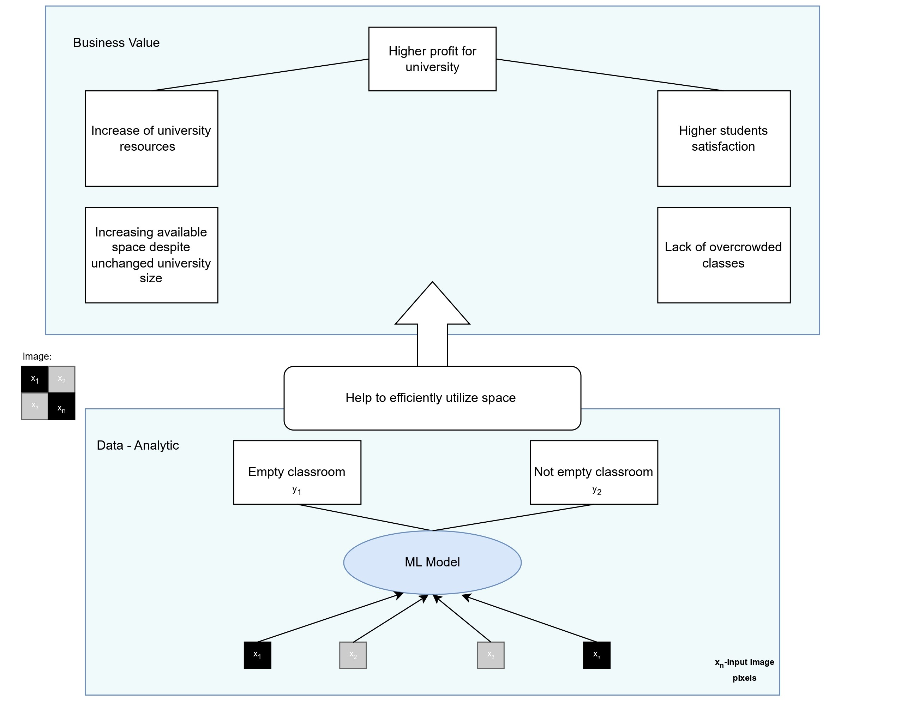
Project Pitch
Business Understanding
Benefits:
-Higher revenue for universities
-More resources for students
-Better accessibility
-Lack of overcrowded classes
Notes:
Time Limit:30 secs
Our application addresses a crucial problem identified through market research within university settings: the inefficiency in quickly identifying and booking accessible study rooms. This issue leads to wasted time and resources, impacting both students and staff productivity negatively. Our main stakeholder, The Innovation Square, represents the university administration responsible for campus facilities and operations.
The needs of The Innovation Square include efficient space utilization to accommodate the growing student population, optimized scheduling and allocation of study spaces, and data-driven insights for making informed decisions regarding resource allocation and space management.
Create the first idea for your application:
Define the problem based on the market research;
Mention your main stakeholder and his needs;
Fill in and present the DAPS diagram;
Explain your idea for an application.
Tell my idea of the APP (how it works, and thanks to that huge universities can better manage their space which will provide them a greater profit. As a result we as student will receive access to more equipment
Basen on market research
To tackle this challenge, we propose a Data-Analytic Problem-Solving (DAPS) approach, outlined in our DAPS diagram. The diagram includes three key components:
1. **Data-Analytic Problem:** Detecting classroom occupancy using machine learning algorithms.
2. **Decision Framework:** Utilizing occupancy data to optimize space management and scheduling.
3. **Business Value:** Enhancing operational efficiency, improving the overall campus experience, and supporting data-driven decision-making in facility management.
Our application concept, named the Classroom Occupancy Detection System (CODS), leverages image classification algorithms to assess visual data from classroom contexts. CODS aims to process and analyze images of classrooms in real-time to determine occupancy status (occupied or vacant). By providing binary classification outputs, CODS aids in optimizing space management and scheduling while supporting decision-making by The Innovation Square to allocate resources effectively and enhance the overall campus experience. This aligns with market demands, addresses stakeholder needs, and offers a practical solution to the identified problem of inefficient space utilization in educational institutions.

Slide 6
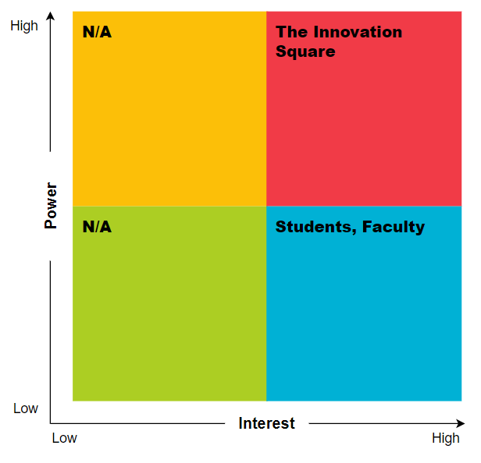
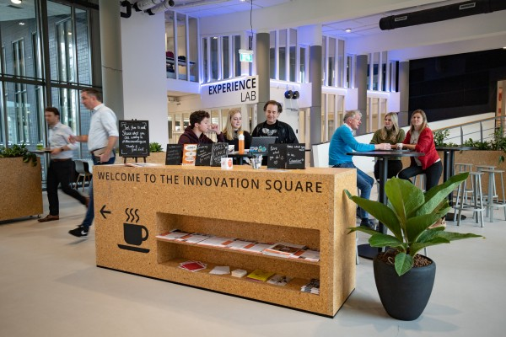
Project Pitch
Business Understanding
Main stakeholder:
The Innovation Square
Figure . The Innovation Square.
Notes:
Time Limit:30 secs
Our main stakeholder is The Innovation Square, representing the university administration responsible for campus facilities and operations. Their needs include efficient space utilization to accommodate the growing student population, optimized scheduling and allocation of study spaces, and data-driven insights for making informed decisions regarding resource allocation and space management.
My main stakeholder is The Innovation Square which focuses on efficient managing , moreover they have collaboration with many companies who could profit from efficient space management

Slide 7
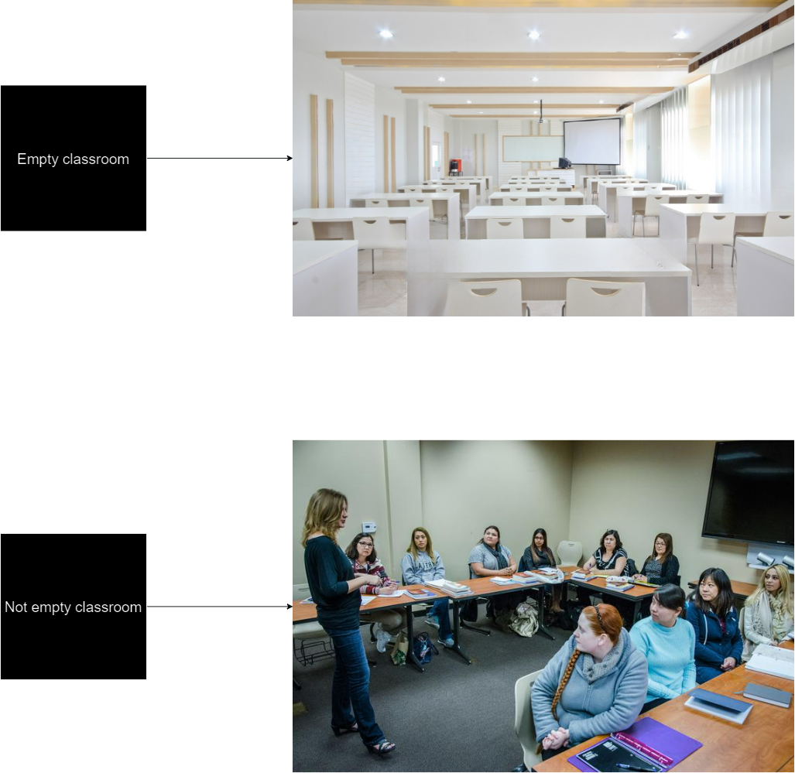
Problem Overview
Deep Learning
My model determines occupancy of classroom based on image
How many pictures per category ?
100 images per class
Notes:
Time Limit: 30 secs
What your model will classify?
How many classes?
Show some examples of classes.
How many image per class?
What your model will classify?
For my image classification problem, I'll be training my model to classify room occupancy status in university classrooms.
How many classes?
I'll classify images into two classes: „empty" or „not empty.
Show some examples of classes.
These are examples of classes
How many image per class?
100 images per class

Slide 8
Problem Overview
Deep Learning
Baselines for my model:
Random guess: 50% accuracy.
Human-level performance: 100% accuracy.
Basic MLP (Multilayer Perceptron): Achieves around 54%
Notes:
Time Limit: Time Limit: 30 secs
This enables to assess with is our end-goal and the accuracy we need to achieve in order to make an efficient model
What your model will classify?
For my image classification problem, I'll be training my model to classify room occupancy status in university classrooms.
How many classes?
I'll classify images into two classes: „empty" or „not empty.
Show some examples of classes.
These are examples of classes
How many image per class?
100 images per class

Slide 9
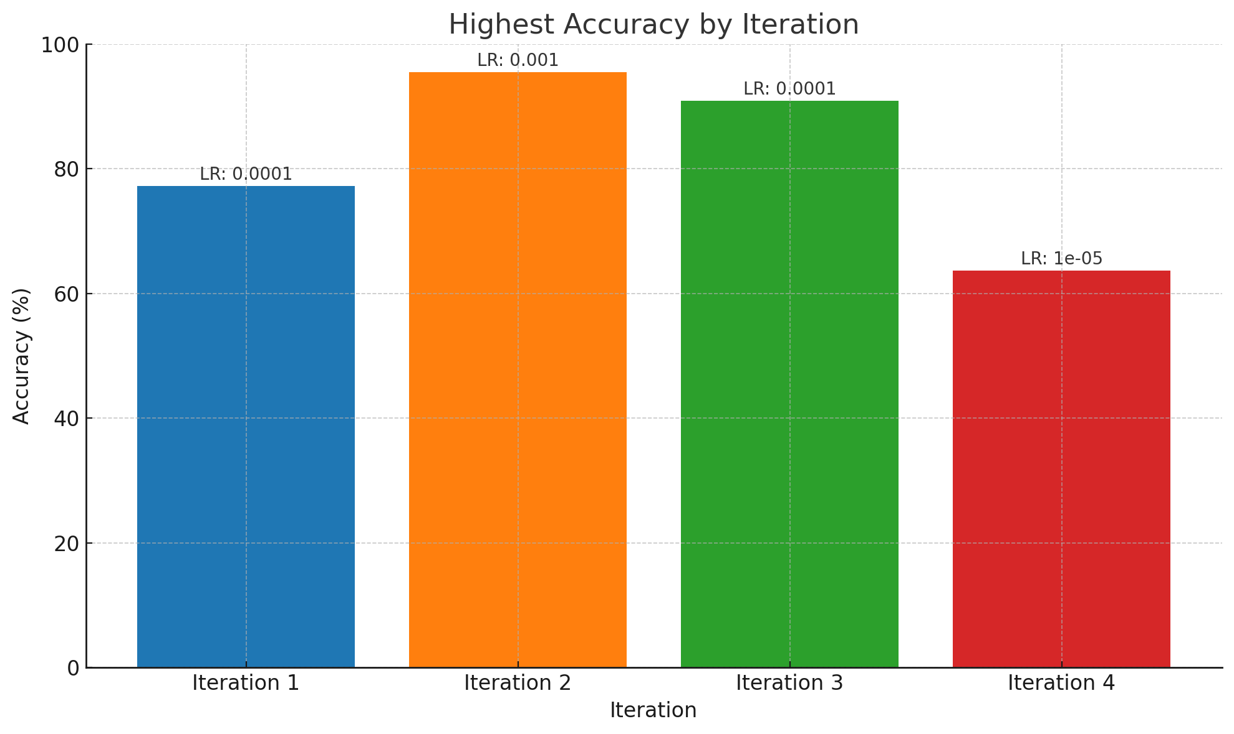
Model Overview
Deep Learning
Iteration 1: Built a basic CNN
Iteration 2: New data augmentation and architecture
Iteration 3: MobileNet
Iteration 4: EfficientNetB1
Notes:
Time :30 secs
Describe the iterations that you performed while building your model (focus on the steps with more impact on the model’s performance).
Iteration 1: Built a basic CNN, experimented with low-resolution images, and simple data augmentation.
Iteration 2: Improved data diversity through direct image import and shuffling, aiming for enhanced learning.
Iteration 3:
Upped image resolution for finer feature capture.
Tested MobileNet for improved feature extraction.
Iteration 4: Further refined by employing EfficientNetB1, maximizing feature extraction capabilities with increased resolution and custom dense layers for precision.

Slide 10
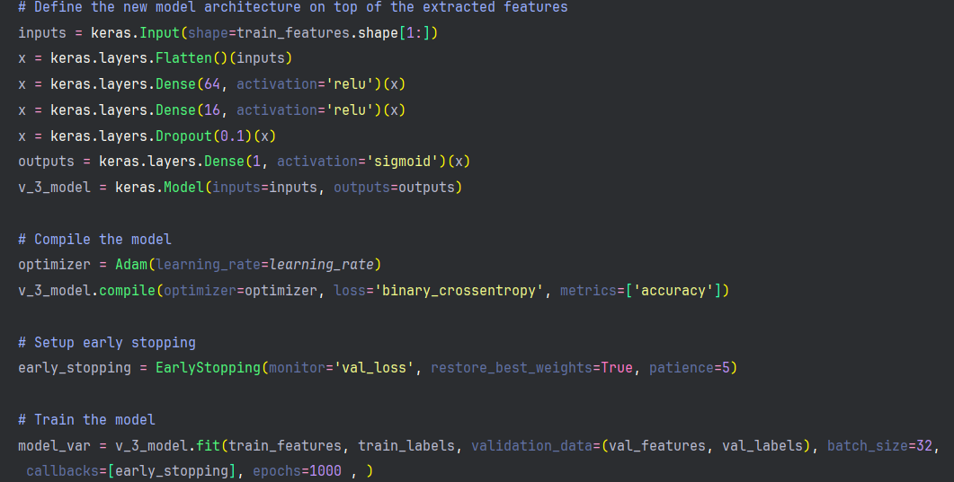
Model Overview
Deep Learning
Final model architecture choice : iteration 3
Accuracy: Approx. 90%
Notes:
Describe the model’s architecture , img-size 224*224

Slide 11
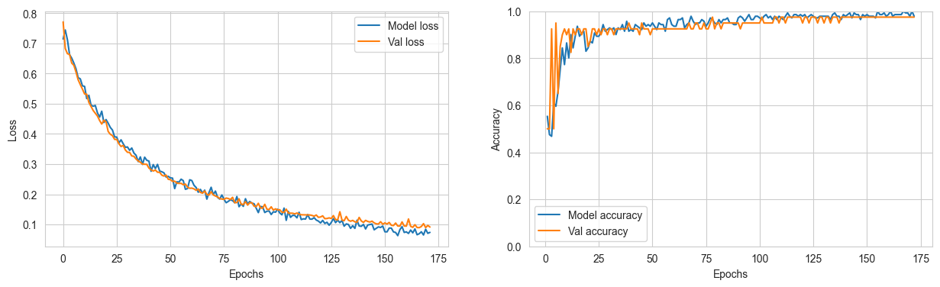
Model Performance
Learning rate: 0.0001
Test accuracy: 0.909 % Test loss: 0.233
Notes:
The model from iteration 3 was selected despite slightly lower accuracy (~90%) than others due to its superior stability and predictability. It demonstrated less overfitting and a steady loss reduction, outweighing the higher accuracy but less consistent performance of other iterations, making it the best choice for practical, real-world application.

Slide 12


Model Interpretability
Accuracy vs. Interpretability:
Priority: High accuracy is essential but bias needs to be addressed
Insights: LIME and GradCAM revealed model’s ability to detect people
Responsible AI
Properly classified „not empty” classroom
Notes:
Time limit: 2 minutes
Priority: High accuracy essential for reliable detection; however, interpretability crucial to address and understand model biases.
Insights: Explained AI methods like LIME and GradCAM revealed the model focuses on both human presence and classroom elements, indicating a sophisticated decision-making process that blends object recognition with contextual understanding.

Slide 13
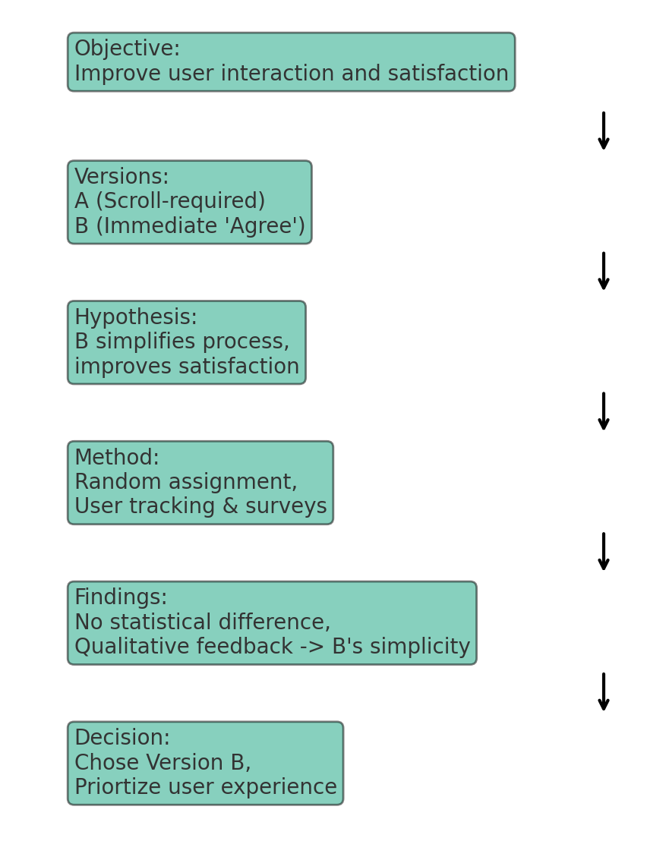
User Study
Human-Centered AI
Objective: Improved user interaction and satisfaction by testing two consent form versions.
Decision: Chose Version B for the final prototype, prioritizing user experience and feedback over statistical significance.
Notes:
Time Limit: 1 minute

Slide 14
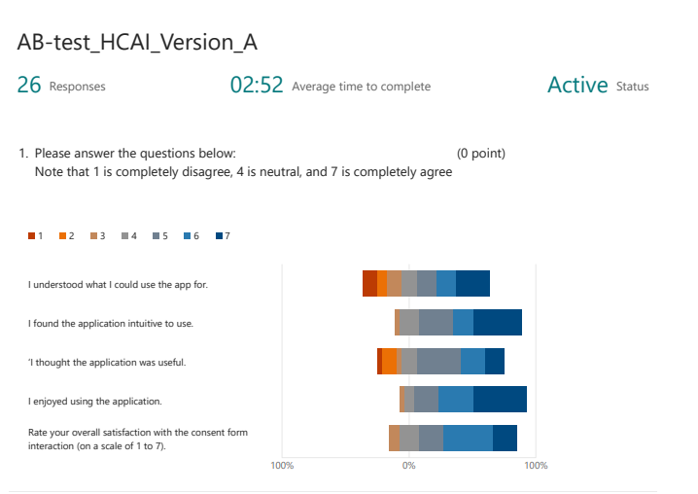
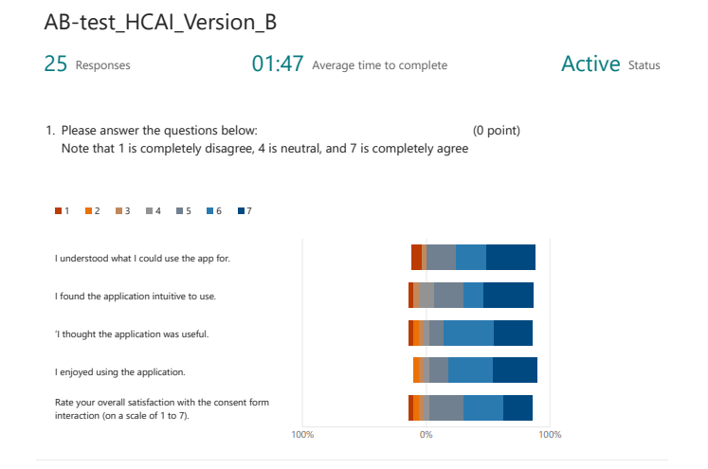
User Study
A/B Testing results
Notes:
More balanced and concised results on the right side and lower average time to complete indicates simplification of UI and possible true effects of the changed prototype
The A/B test results indicate a slight improvement in user interaction with version B, reflected in lower completion times. This suggests the simplified UI may have positively influenced user experience. However, further analysis is needed to determine the full impact of the changes, considering the non-normal distribution of data and potential biases in survey responses.

Slide 15

Demo
Human-Centered AI

Slide 16
Thank you!
Any questions?

